Slide 1
Sentiment Analysis of Presidential Candidate Speeches During the Pandemic
Edgar Guzman

Slide 2

Question
COVID-19 and Statewide Shutdowns led to a major shift in the political climate.
62% of sampled voters said the coronavirus outbreak was a top issue in the 2020 election
How did presidential candidates shift their campaign platform based on this issue?
What impact did COVID-19 have on the rhetoric of presidential candidates? Do we see a change in speeches before the event became mainstream news?
Are speeches more comforting? More blaming? More positive? Was there no change?
Source: https://www.pewresearch.org/politics/2020/08/13/important-issues-in-the-2020-election/

Slide 3
hYPOTHESIS
We would like to visualize voter trends and resultant voting outcomes based on presidential rhetoric to determine what can benefit or damage a political platform.
We expect to see a significant decrease in speech sentiment as speeches start to bring up COVID-19 and the pandemic.
We will measure speeches before and after February 11, 2020, The day the WHO officially announces the disease name “COVID-19”
Source: https://www.cdc.gov/museum/timeline/covid19.html

Slide 4
data
Our data comes from the 2020 Campaign speeches for U.S. presidential election GutHib repository.
Contains transcriptions of public speeches given by presidential candidates (C-SPAN, Miller Center, Vote Smart) during their 2019-2020 campaign.
Contains speech dates in DateTime format, allowing us to easily create time-series graphs.
Source: https://github.com/ichalkiad/datadescriptor_uselections2020/tree/main

Slide 5
Approach
We will use R to develop multiple analyses from our data:
Net Sentiment Analysis of Speeches by President
LDA and Sentiment Analysis Grouped by Speech Topic
Topic Prevalence of COVID-19 in Speeches
Logistic Regression to Predict if a Topic was Related to COVID

Slide 6
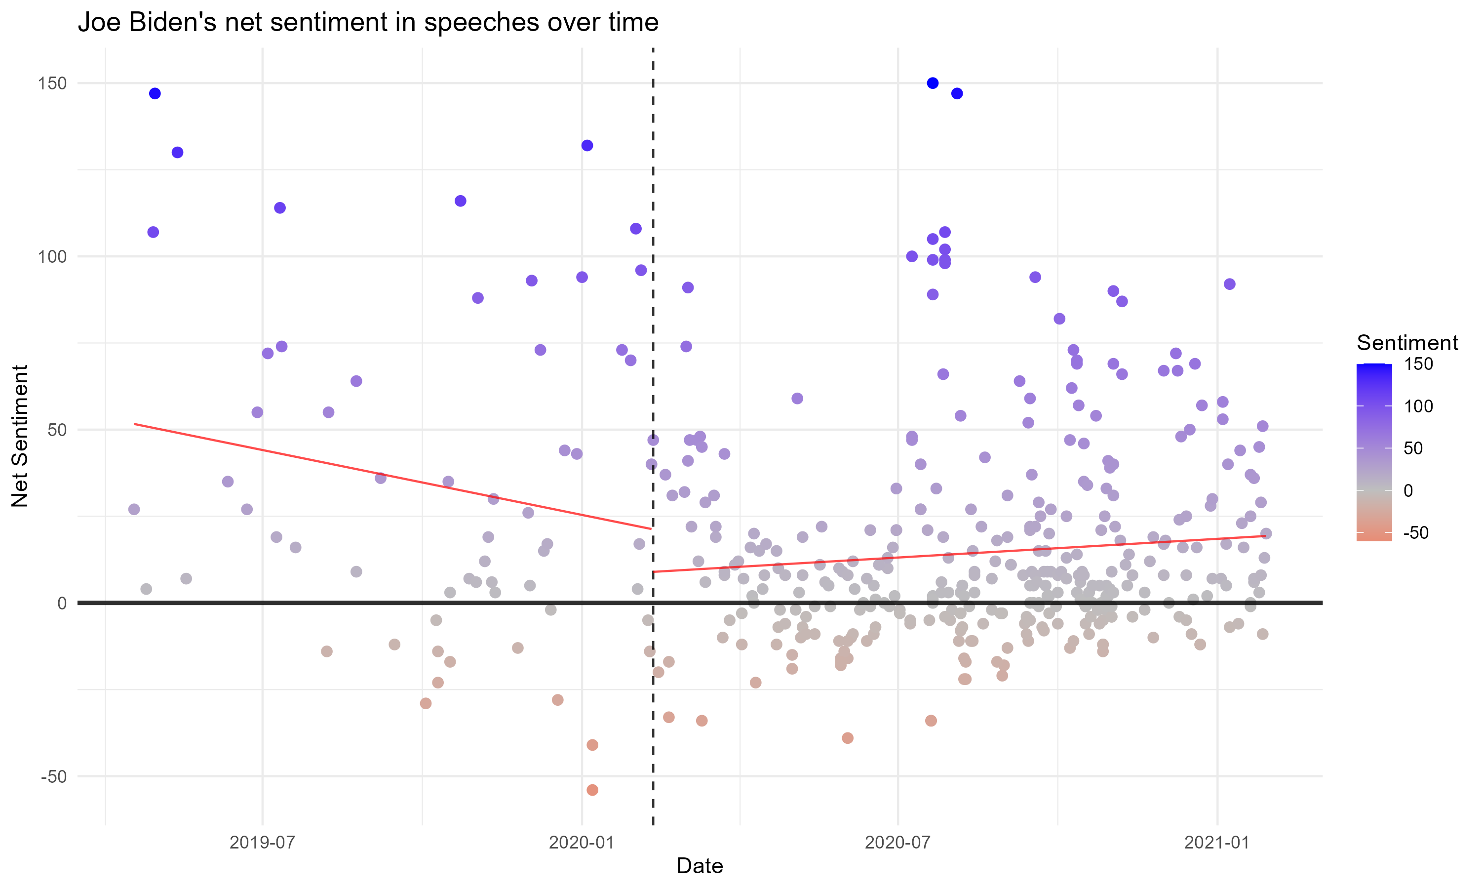
Net Sentiment analysis
Joe Biden’s Speeches contain both positive and negative sentiment, resulting in many neutral speeches.
High: ~150
Low: ~ -50

Slide 7
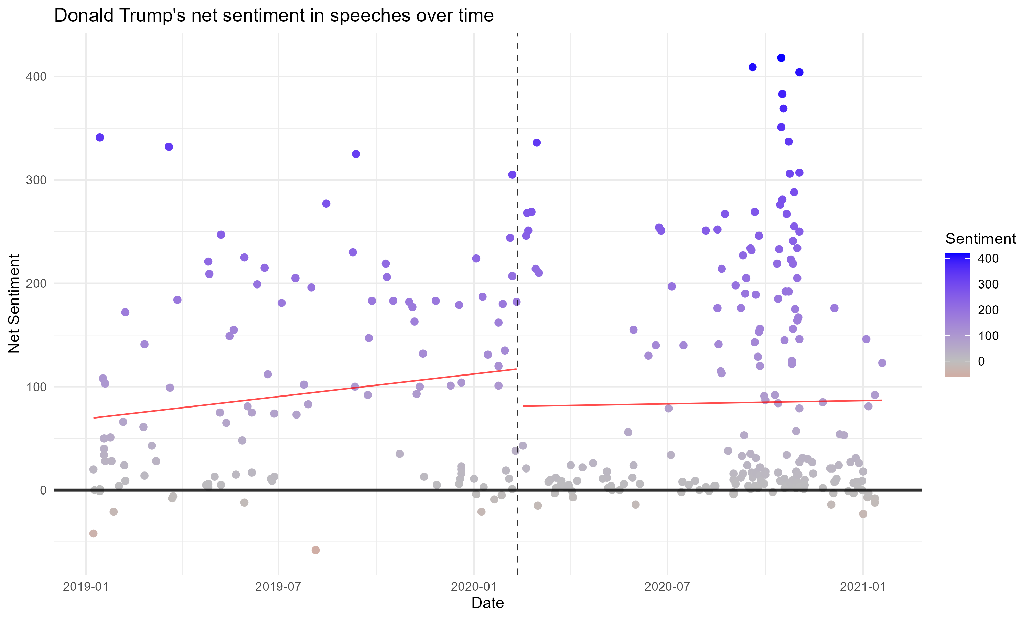
Net Sentiment analysis
Trumps Speeches are more positive, especially during Election Week. Trump also started campaigning earlier than Biden.
High: ~400
Low: ~-60

Slide 8
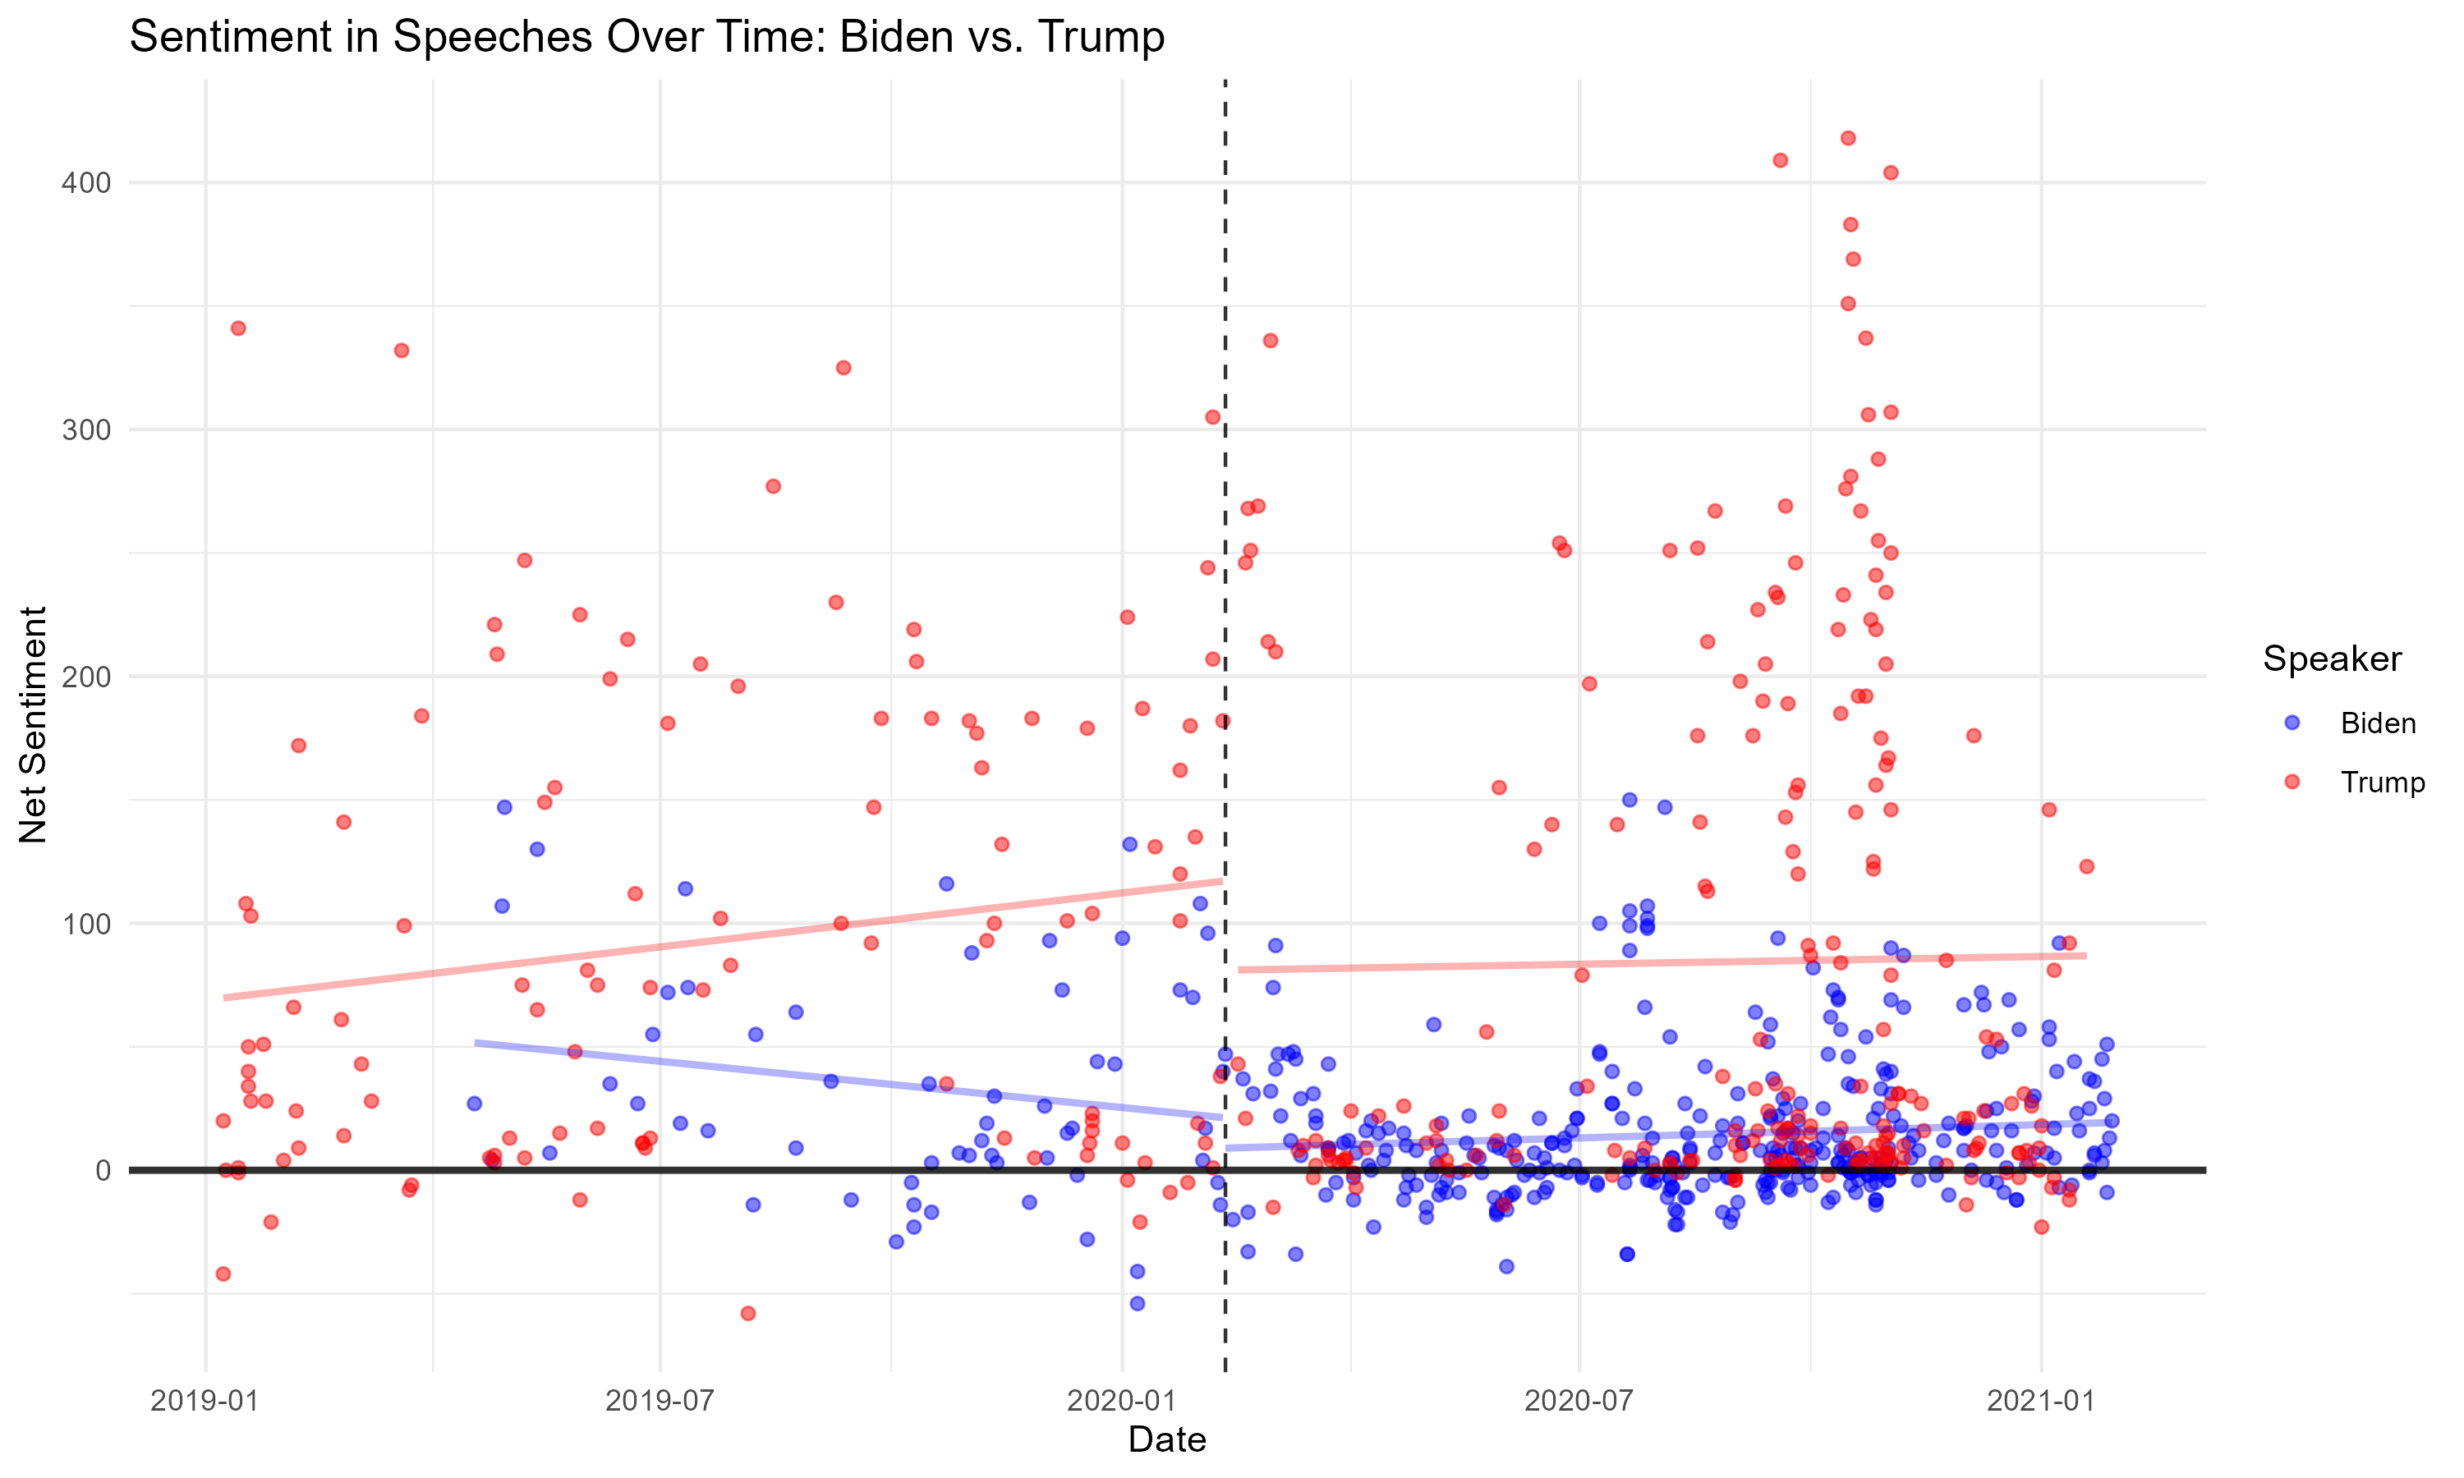
Net Sentiment analysis
Combined sentiment graphs
Both regression lines after February 11 are lower than they were before
Why are Donald Trump’s Speeches more positive?

Slide 9
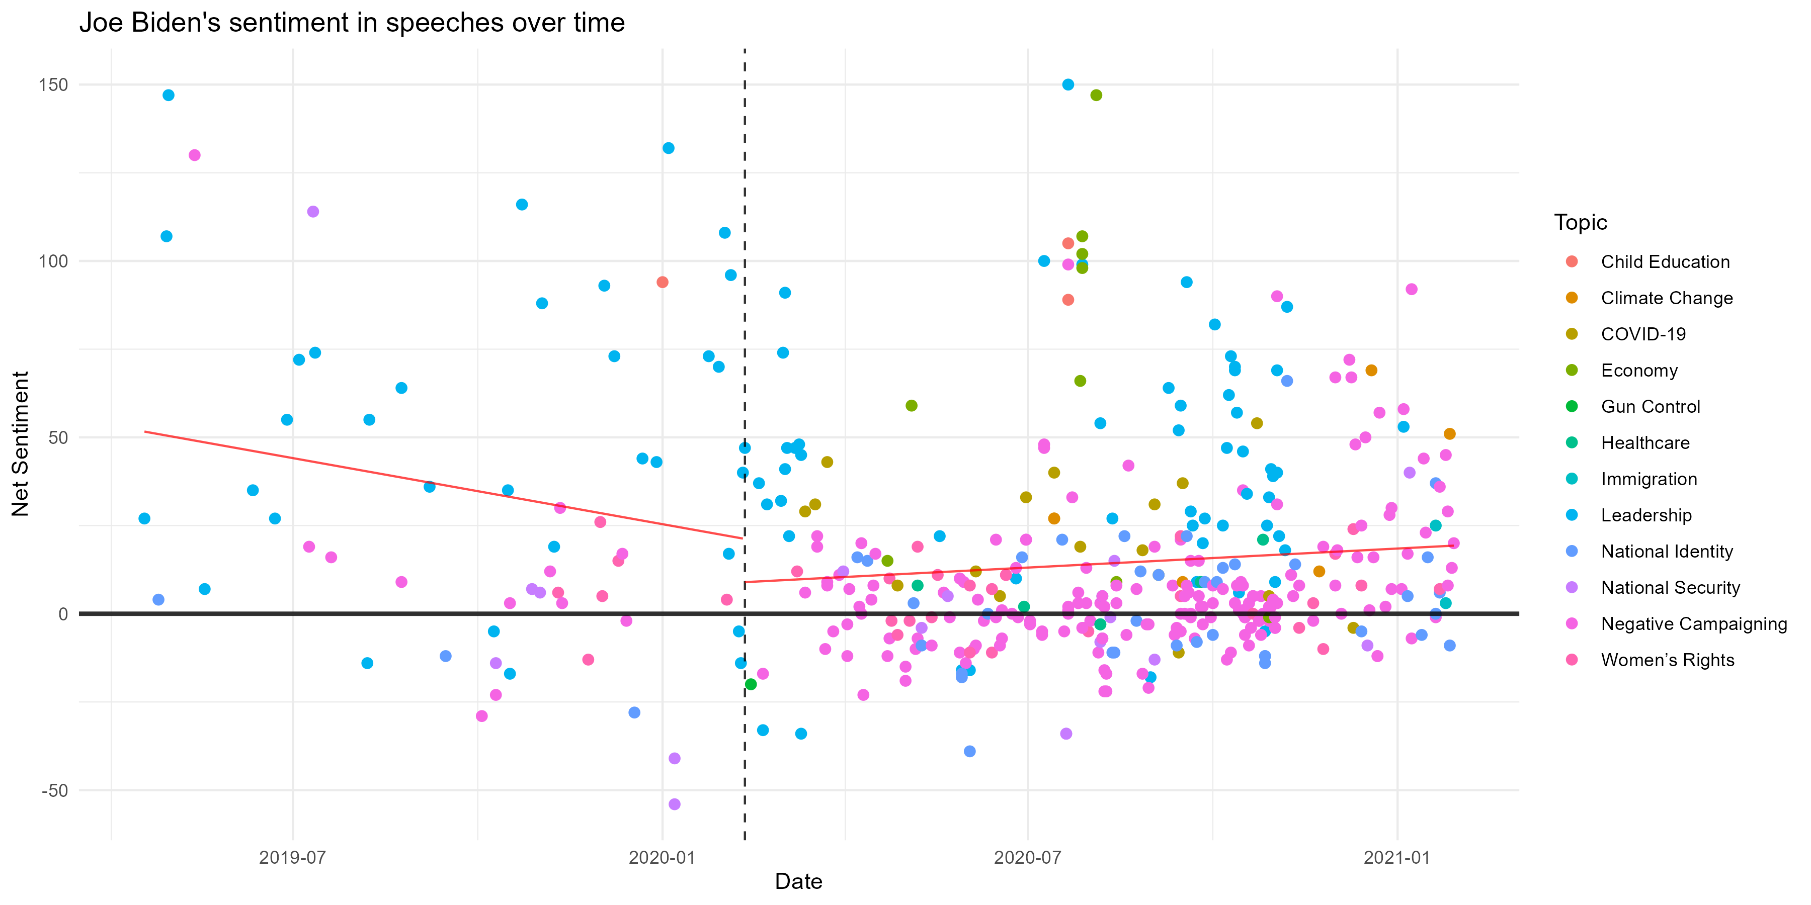
LDA and Topic Clustering
Biden’s primary topics included Leadership skills and “Negative” Campaigning
COVID-19 Speeches tend to be slightly positive, denoting hopeful and caring outcomes
Negative Campaigning
Leadership

Slide 10
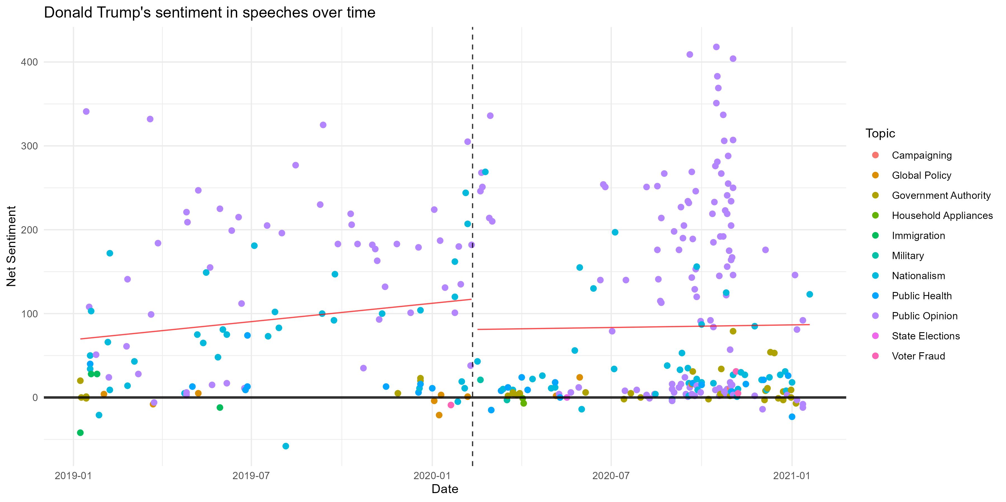
LDA and Topic Clustering
Trump’s primary topics included Public Opinion and Public Health
Election Week Speeches are overwhelmingly positive, signaling that positivity was about public opinions spun towards himself.
Minimal COVID topics
Public Opinion
Public Health

Slide 11
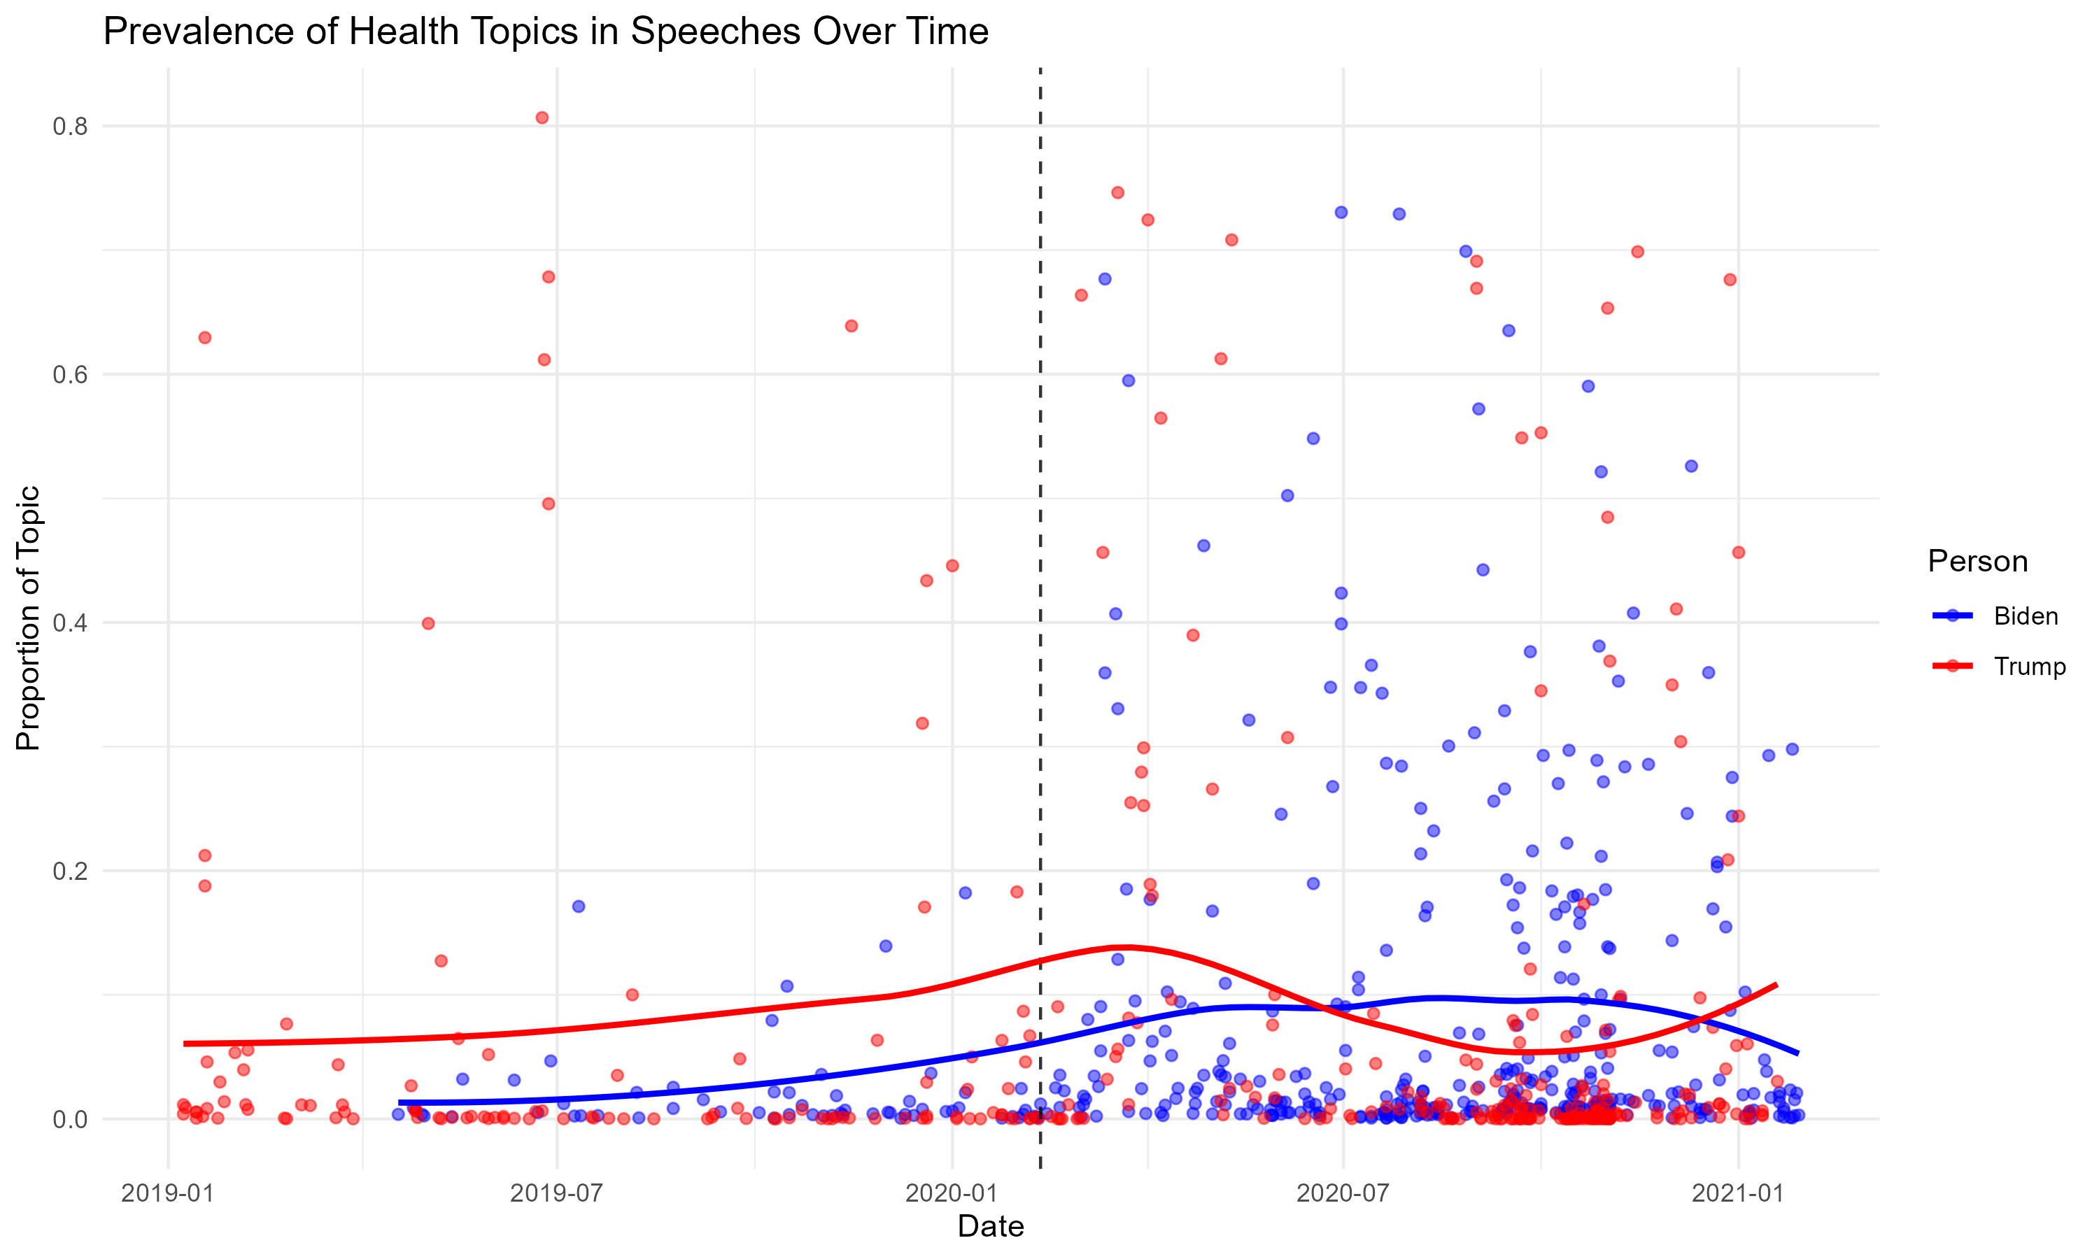
Topic Prevalence
Did speeches related to COVID-19 impact sentiment?
Yes!
Increase in COVID Topic prevalence resulted in more neutral/negative speeches

Slide 12
Topic Prevalence
Biden’s speeches would comment on Donald Trump’s failure as a leader to contain COVID-19 properly
Trump mentions the coronavirus as it begins but shifts his platform away from Public Health to Public Opinions about his party.

Slide 13
Hand Coding
To determine whether a speech was related to the pandemic, we hand coded 100 (50B, 50T) observations.
“1” if the speech contained keywords such as “COVID-19”, “Coronavirus” “Pandemic”, or “Vaccine”.
“0” Otherwise.
We then run Logistic Regression with K-Fold CV to categorically classify topics.
Simple to use
Can use related variables for prediction (Sentiment, Topic Prevalence)

Slide 14
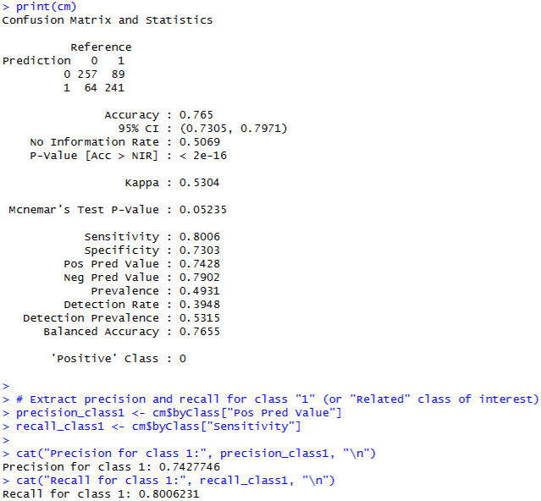
Results
>75% accuracy to predict out of 20+ topics is a very strong indication of a working model
Precision: 0.74
Recall: 0.80
At .05, we fail to reject our null hypothesis. A change in regression model can improve our confusion matrix.

Slide 15
Limitations and final remarks
To improve our model, we would need to include Topic Name in the formula. Too many R errors prevented us from using them.
Public broadcasts tend to skew towards positivity as more people are reached. Social Media posts would show significantly higher negative sentiment if used.
Our next steps will be to implement both factors in our next project.

